Slide 1
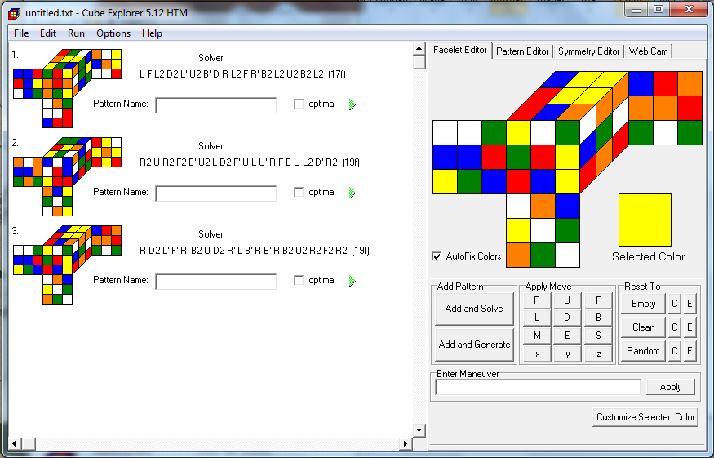
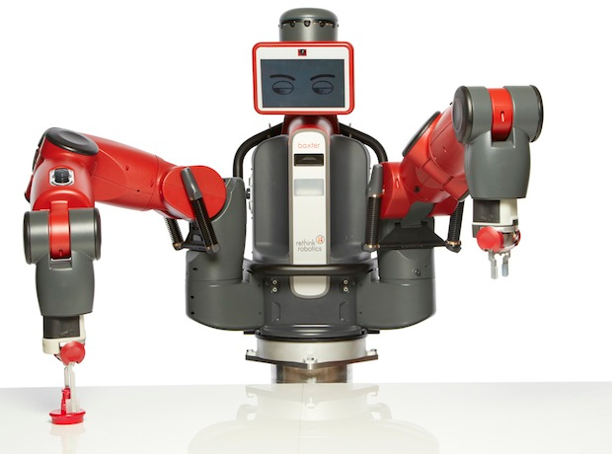
Baxter Research Robot: Solving a Rubik’s Cube
Background
Robotics is applied in industry as simple repetition.
This repetition limits the applications of robotics.
Artificial Intelligence (AI) is fragmented, with well developed systems being highly specialized.
Applying AI to robotics will allow robots to be applied to dynamic applications outside of industry.
Project Objectives
Demonstrate the use of the Baxter Research Robot to solve a Rubik’s cube.
Demonstrated by developing an algorithm to combine the servo and vision system of the Baxter Research Robot with a solving algorithm.
Significance
Show the application of simple AI to complete complex tasks.
Could change how robots are used in industry, and allow them to function in dynamic environments.
Proposed Approach
Divided into three parts
Part 1: Vision System
Part 2: Solving Algorithm
Part 3: Motion Planning
Figure 2: Cube Explorer 5.12 main interface
The Baxter Research Robot
Dual arm robot with 7 degrees of freedom per arm.
Offers motions simular to humans.
Three cameras; one on each wrist and one on head.
Designed to be used around humans – requires no safety cage.
Built specifically for research applications.
Same hardware as its industrial counterpart.
Part 1: Vision System
Developed using OpenCV, a library of algorithms for computer vision.
Will use edge detection to find each colour section.
Colour of section will be sampled and recorded.
Part 3: Motion Planning
Use MoveIt to plan inverse kinematics.
Motion planning required to pickup Rubik’s cube, position it from scanning, manipulate cube faces and finally place back down.
Figure 1: Baxter Robot
Retrieved from: http://spectrum.ieee.org/img/baxter-robot-photo-credit-ieee-spectrum-1367871874741.jpg
Part 2: Solving Algorithm
Using Cube Explorer 5.12
Uses a two-phase algorithm to find optimal and suboptimal solutions.
Suboptimal solutions will be used.
Future Work
Continue development of vision system using OpenCV.
Develop movements using MoveIt
By: CHRISTOPHER DAWES
Supervisor: Dr Alexander Rassau

